Slide 1
Gerunds; short responses, positive and negative adjectives

Slide 2
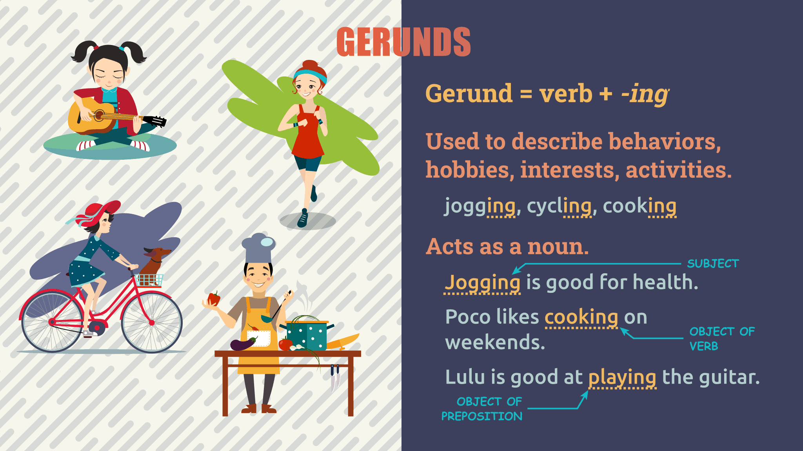
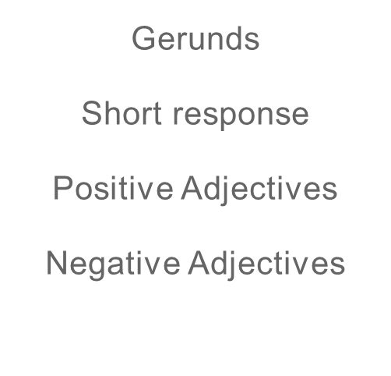


Agenda

Slide 3


Gerunds
In some situations you can use gerunds as nouns, when you do that you're referring to the action expressed by the verb in gerund. Gerunds can be the subject or the object of a sentence.
Swimming is good for you.
I don't like swimming.
We're going to focus on sentences like the second one. Gerunds can be used after a verb to talk about them.
Example:
I like running

Slide 4
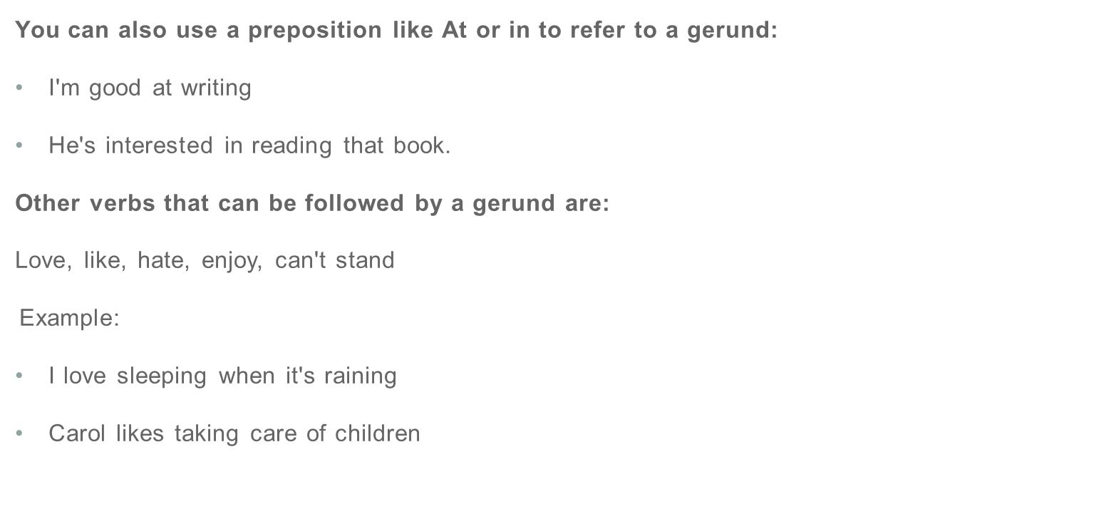


Slide 5
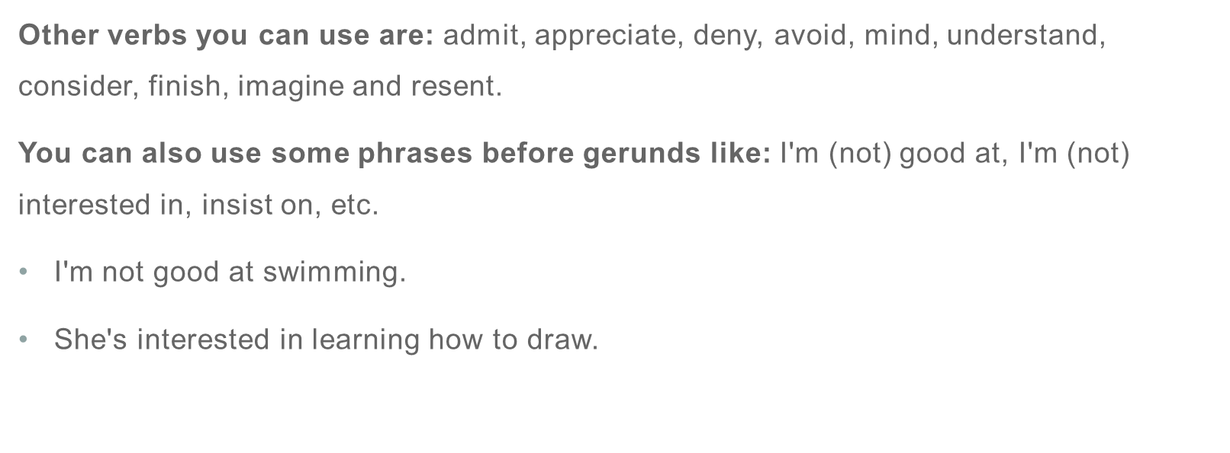


Slide 6


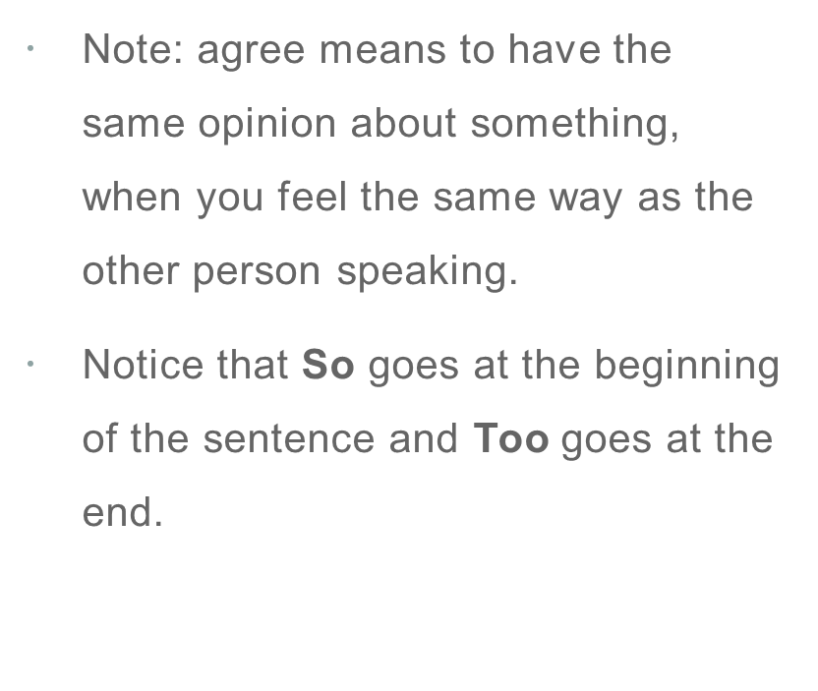



Short responses with so, too, neither, either

Slide 7
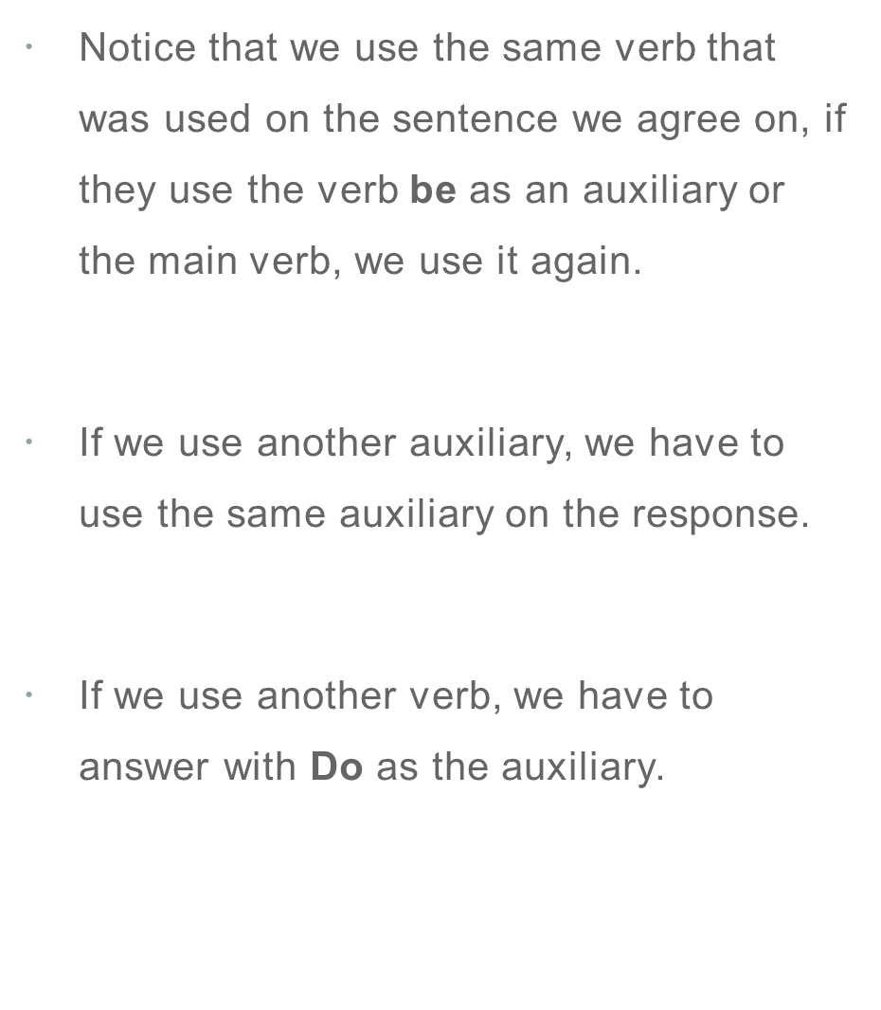





Slide 8
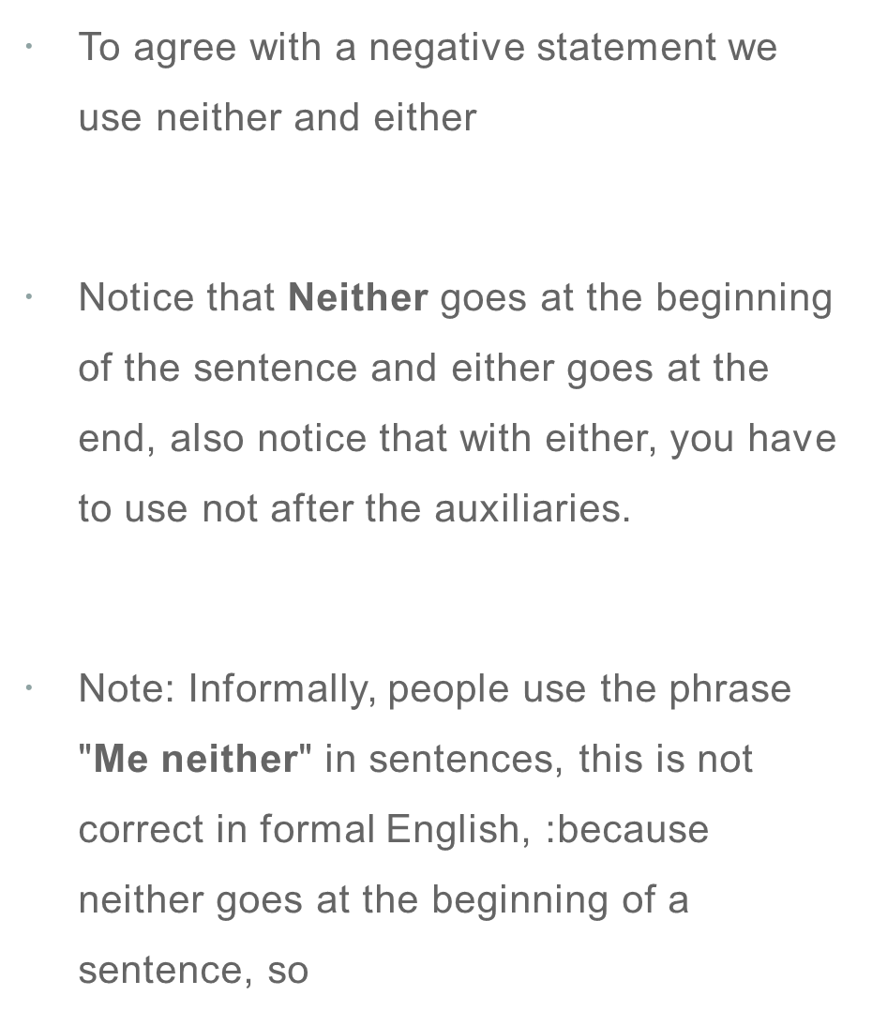





Slide 9
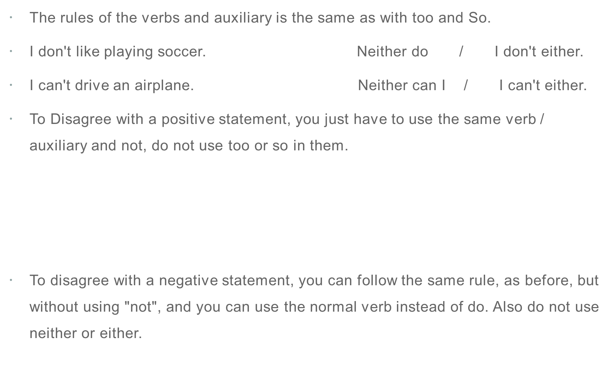



Slide 10

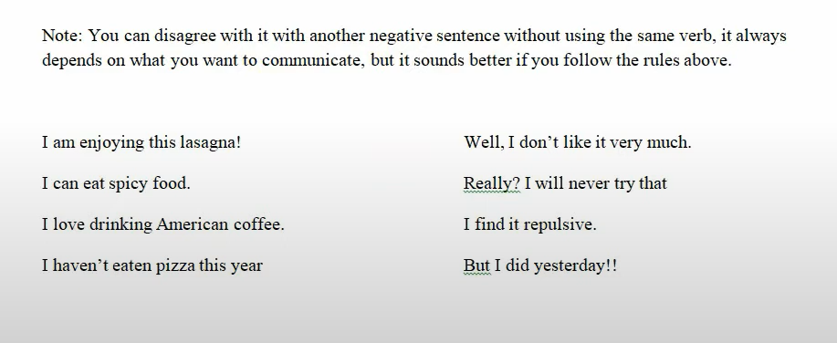


Slide 11
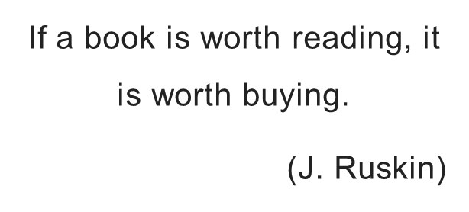

Thank you

